Slide 1

Network+ Guide to Networks 6th Edition
Chapter 5
Topologies and Ethernet Standards

Slide 2
Objectives
Describe the basic and hybrid LAN topologies, and their uses, advantages, and disadvantages
Describe the backbone structures that form the foundation for most networks
Compare the different types of switching used in data transmission
Explain how nodes on Ethernet networks share a communications channel
Identify the characteristics of several Ethernet standards

Slide 3
Simple Physical Topologies
Physical topology
Physical network nodes layout
Depicts broad scope
Does not specify:
Device types
Connectivity methods
Addressing schemes
Fundamental shapes
Bus, ring, star
Hybrid

Slide 4
Bus
Bus topology
Single cable
Connects all network nodes
No intervening connectivity devices
One shared communication channel
Physical medium
Coaxial cable
Passive topology
Node listens for, accepts data
Uses broadcast to send

Slide 5
Bus (cont’d.)
Terminators
50-ohm resistors
Stop signal at end of wire
Signal bounce
Signal travels endlessly between two network ends
One end grounded
Removes static electricity

Slide 6
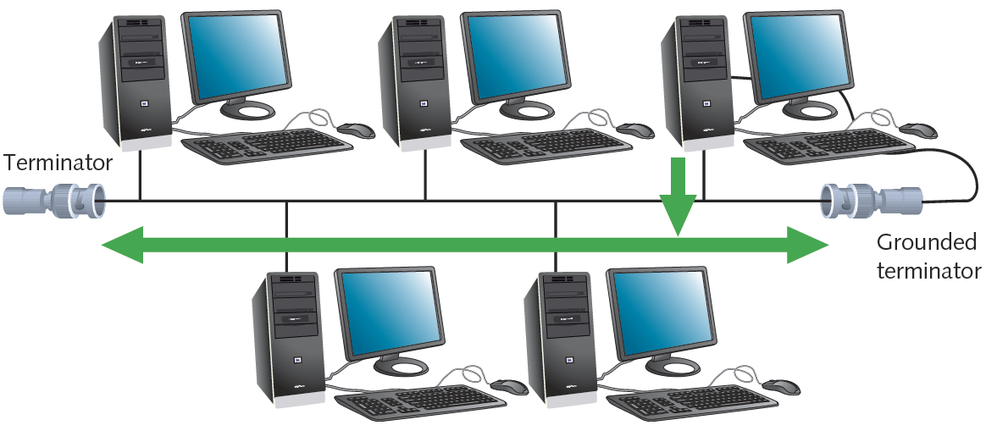
Figure 5-1 A terminated bus topology network
Courtesy Course Technology/Cengage Learning

Slide 7
Bus (cont’d.)
Bus topology advantage
Relatively inexpensive
Disadvantages
Does not scale well
Difficult to troubleshoot
Not very fault tolerant

Slide 8
Ring
Ring topology
Node connects to nearest two nodes
Circular network
Clockwise data transmission
One direction (unidirectional) around ring
Active topology
Workstation participates in data delivery
Data stops at destination
Physical medium
Twisted pair or fiber-optic cabling

Slide 9
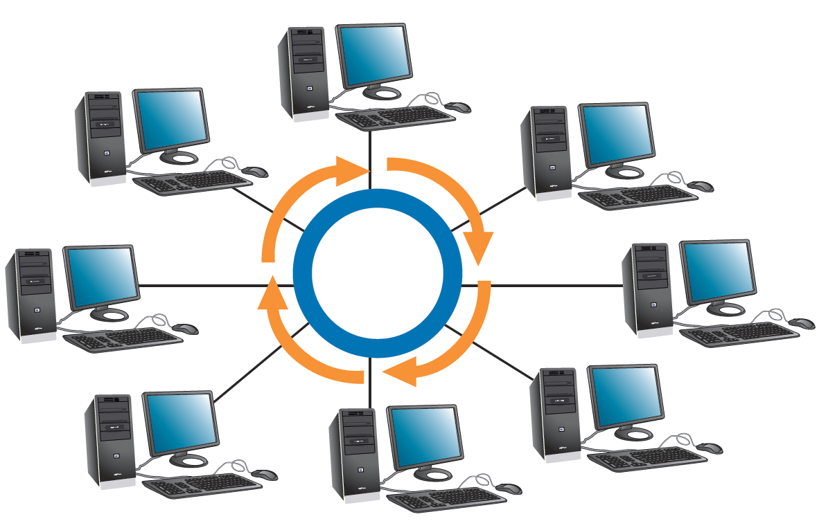
Ring (cont’d.)
Drawbacks
Malfunctioning workstation can disable network
Not very flexible or scalable
Figure 5-2 A ring topology network
Courtesy Course Technology/Cengage Learning

Slide 10
Star
Star topology
Node connects through central device
Router or switch
Physical medium
Twisted pair or fiber-optic cabling
Single cable connects only two devices
Advantage
Fault tolerant
Flexible

Slide 11
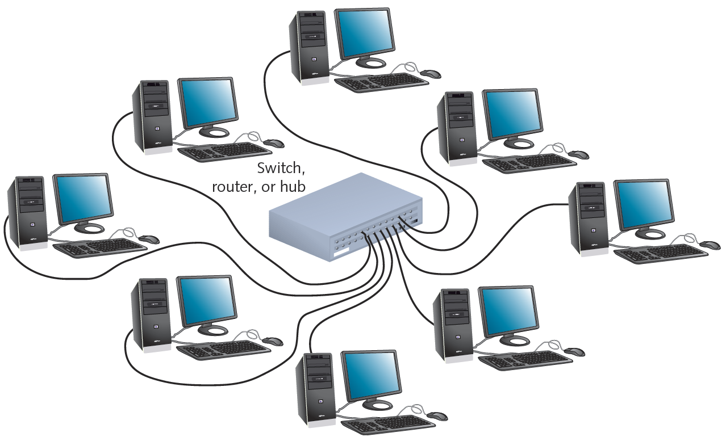
Star (cont’d.)
Most popular fundamental layout
Modern Ethernet networks based on star topology
1024 addressable logical network nodes maximum
Figure 5-3 A star topology network
Courtesy Course Technology/Cengage Learning

Slide 12
Hybrid Topologies
Pure bus, ring, star topologies
Rarely exist because too restrictive
Hybrid topology
More likely
Complex combination of pure topologies
Several options

Slide 13
Star-Wired Ring
Star-wired ring topology
Star physical topology
Ring logical topology
Benefit
Star fault tolerance
Network use
Token Ring networks
IEEE 802.5

Slide 14
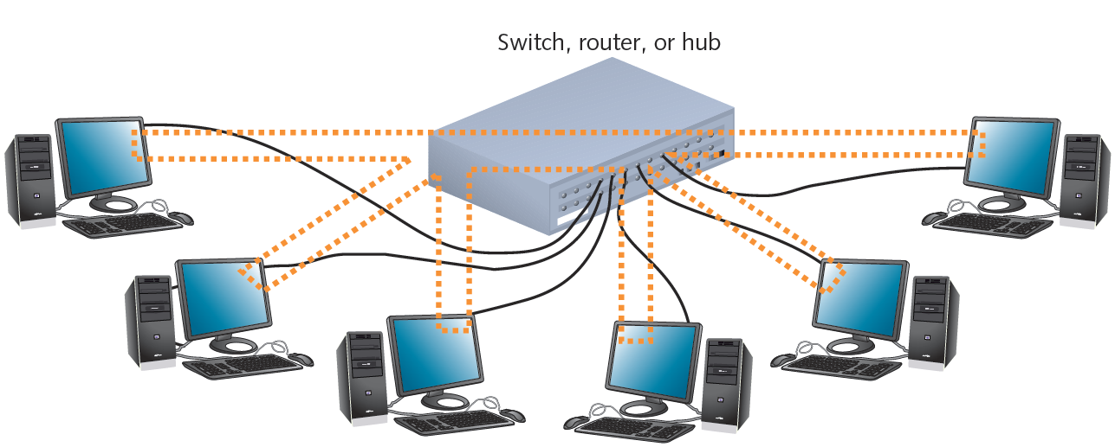
Star-Wired Ring (cont’d.)
Figure 5-4 A star-wired ring topology network
Courtesy Course Technology/Cengage Learning

Slide 15
Star-Wired Bus
Star-wired bus topology
Workstation groups
Star-connected devices
Networked via single bus
Advantage
Cover longer distances
Easily interconnect, isolate different segments
Drawback
Cabling, connectivity device expense
Basis for modern Ethernet networks

Slide 16
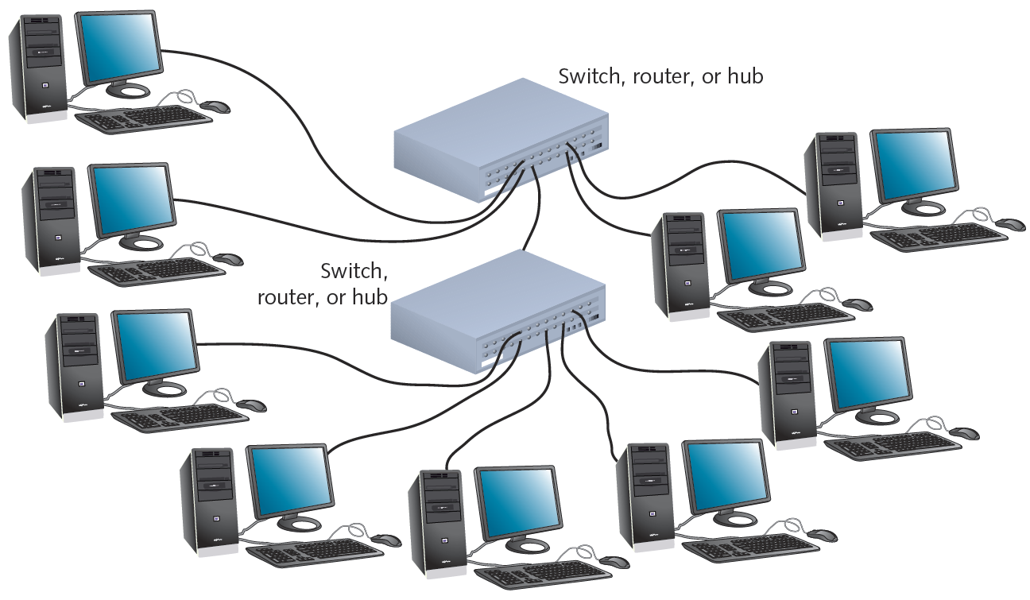
Star-Wired Bus (cont’d.)
Figure 5-5 A star-wired bus topology network
Courtesy Course Technology/Cengage Learning

Slide 17
Logical Topologies
Refers to way data transmitted between nodes
Rather than physical layout
Does not necessarily match physical topology
Most common: bus and ring
Broadcast domain
All nodes connected to single repeating device or switch

Slide 18
Backbone Networks
Cabling connecting hubs, switches, routers
More throughput
Large organizations
Fiber-optic backbone
Cat 5 or better for hubs, switches
Enterprise-wide network backbones
Complex, difficult to plan
Enterprise
Entire organization
Significant building block: backbone

Slide 19
Serial Backbone
Simplest backbone
Two or more devices
Connect using single medium in daisy-chain fashion
Daisy-chain
Linked series of devices
Benefit
Logical growth solution
Modular additions
Low-cost LAN infrastructure expansion
Easily attach switches

Slide 20
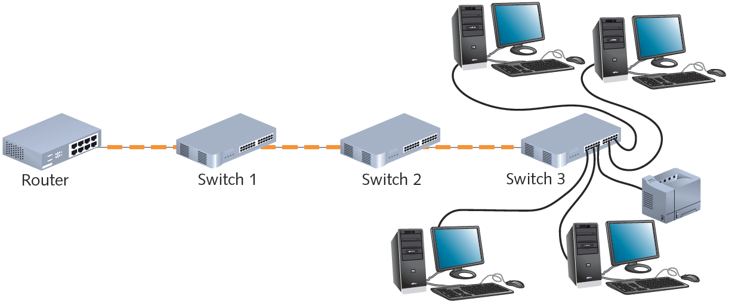
Serial Backbone (cont’d.)
Backbone components
Gateways, routers, switches
Figure 5-6 A serial backbone
Courtesy Course Technology/Cengage Learning

Slide 21
Serial Backbone (cont’d.)
Serial connection of repeating devices
Limited distance spanned between each
Standards
Define number of repeating devices allowed
Exceed standards
Intermittent, unpredictable data transmission errors
Not used in modern networks

Slide 22
Distributed Backbone
Connectivity devices
Connected to hierarchy of central connectivity devices
Benefit
Simple expansion, limited capital outlay
More complicated distributed backbone
Connects multiple LANs, LAN segments using routers

Slide 23
Distributed Backbone (cont’d.)
Additional benefits
Workgroup segregation
May include daisy-chain linked repeating devices
Consider length
Drawback
Potential for single failure points

Slide 24
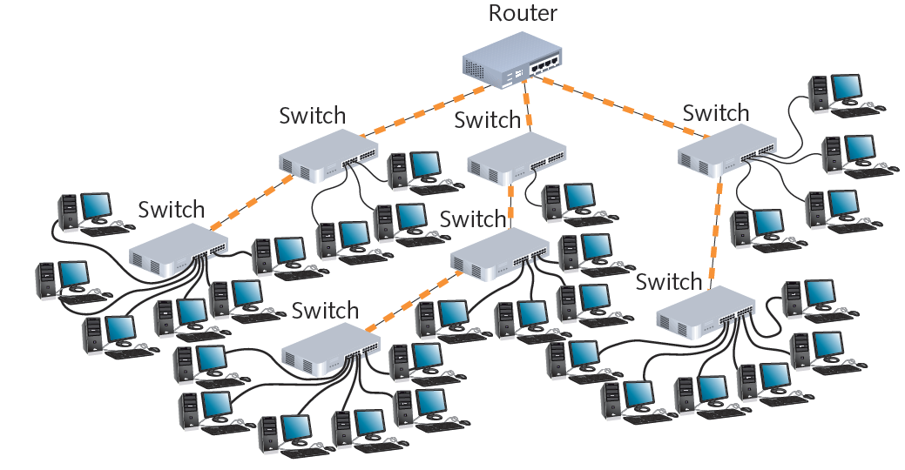
Figure 5-7 A simple distributed backbone
Courtesy Course Technology/Cengage Learning

Slide 25
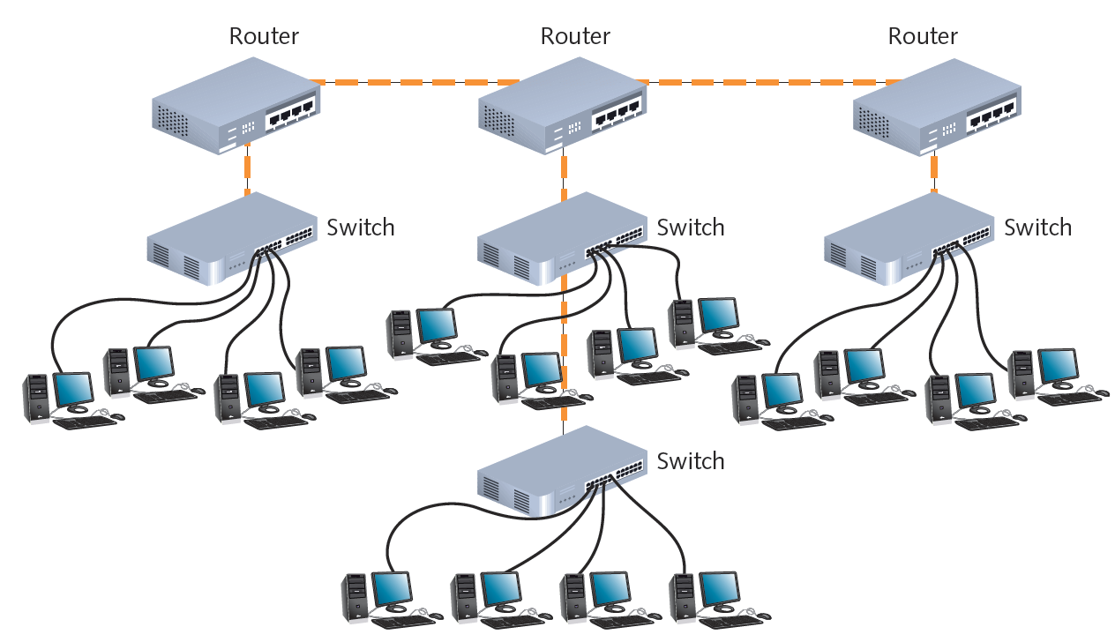
Figure 5-8 A distributed backbone connecting multiple LANs
Courtesy Course Technology/Cengage Learning

Slide 26
Collapsed Backbone
Uses router or switch
Single central connection point for multiple subnetworks
Highest layer
Single router or switch with multiprocessors
Central router failure risk
Routers may slow data transmission
Advantages
Interconnect different subnetwork types
Central management

Slide 27
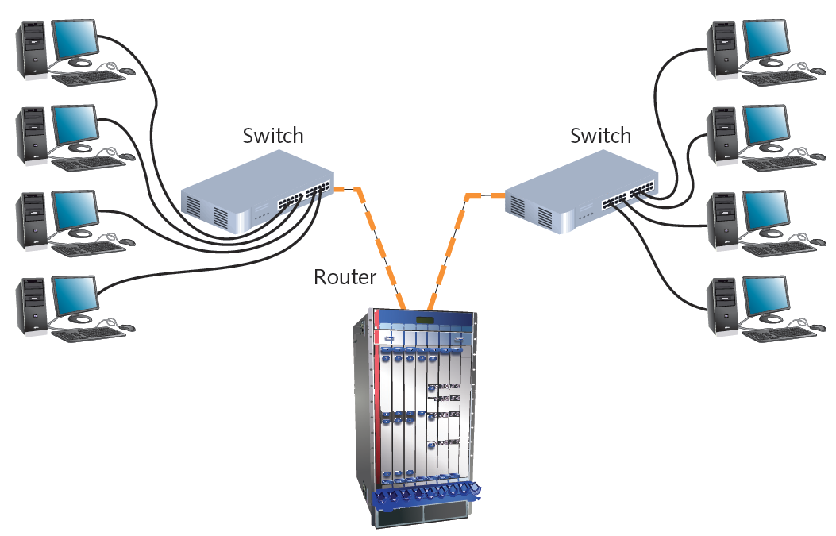
Figure 5-9 A collapsed backbone
Courtesy Course Technology/Cengage Learning

Slide 28
Parallel Backbone
Most robust network backbone
More than one central router, switch
Connects to each network segment
Requires duplicate connections between connectivity devices
Advantage
Redundant links
Increased performance
Better fault tolerance

Slide 29
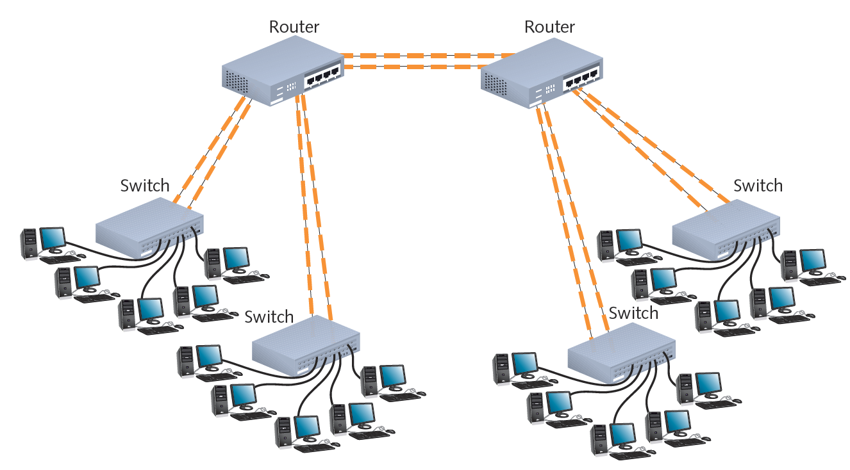
Figure 5-10 A parallel backbone
Courtesy Course Technology/Cengage Learning

Slide 30
Switching
Logical network topology component
Determines connection creation between nodes
Three methods
Circuit switching
Packet switching
Multiprotocol label switching

Slide 31
Circuit Switching
Connection established between two network nodes
Before transmitting data
Dedicated bandwidth
Data follows same initial path selected by switch
Monopolizes bandwidth while connected
Resource wasted
Uses
Live audio, videoconferencing
Traditional telephone calls

Slide 32
Packet Switching
Most popular
Breaks data into packets before transporting
Packets
Travel any network path to destination
Find fastest circuit available at any instant
Need not follow each other
Need not arrive in sequence
Reassembled at destination
Requires speedy connections for live audio, video transmission

Slide 33
MPLS (Multiprotocol Label Switching)
Introduced by IETF in 1999
Enables multiple types of Layer 3 protocols:
To travel over any one of several Layer 2 protocols
Most often supports IP
Common use
Layer 2 WAN protocols
Offers potentially faster transmission than packet- or circuit-switched networks

Slide 34
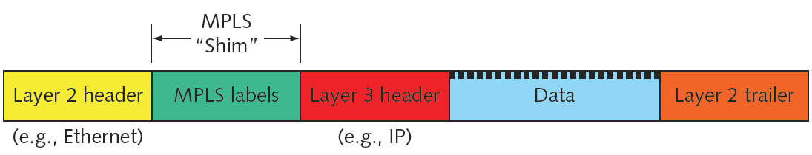
MPLS (cont’d.)
Advantages
Use packet-switched technologies over traditionally circuit switched networks
Create end-to-end paths
Addresses traditional packet switching limitations
Better QoS (quality of service)
Figure 5-11 MPLS shim within a frame
Courtesy Course Technology/Cengage Learning

Slide 35
Ethernet
Most popular networking technology used on modern LANs
Benefits
Flexible
Can run on various network media
Excellent throughput
Reasonable cost
All variations
Share common access method
CSMA/CD

Slide 36
CSMA/CD (Carrier Sense Multiple Access with Collision Detection)
Network access method
Controls how nodes access communications channel
Necessary to share finite bandwidth
Carrier sense
Ethernet NICs listen, wait until free channel detected
Multiple access
Ethernet nodes simultaneously monitor traffic, access media

Slide 37
CSMA/CD (cont’d.)
Collision
Two nodes simultaneously:
Check channel, determine it is free, begin transmission
Collision detection
Manner nodes respond to collision
Requires collision detection routine
Enacted if node detects collision
Jamming
NIC issues 32-bit sequence
Indicates previous message faulty

Slide 38
CSMA/CD (cont’d.)
Heavily trafficked network segments
Collisions common
Segment growth
Performance suffers
“Critical mass” number dependencies
Data type and volume regularly transmitted
Collisions corrupt data, truncate data frames
Network must detect and compensate

Slide 39
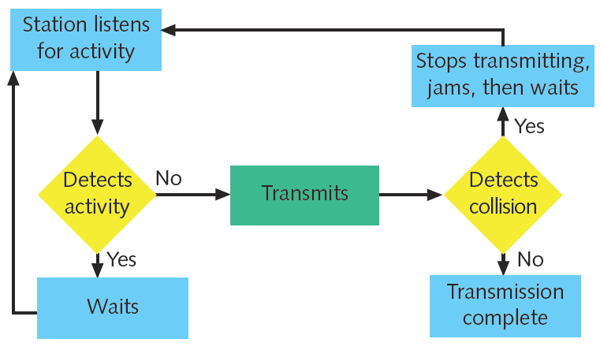
Figure 5-12 CSMA/CD process
Courtesy Course Technology/Cengage Learning

Slide 40
CSMA/CD (cont’d.)
Collision domain
Portion of network where collisions occur
Ethernet network design
Repeaters repeat collisions
Result in larger collision domain
Switches and routers
Separate collision domains
Collision domains differ from broadcast domains

Slide 41
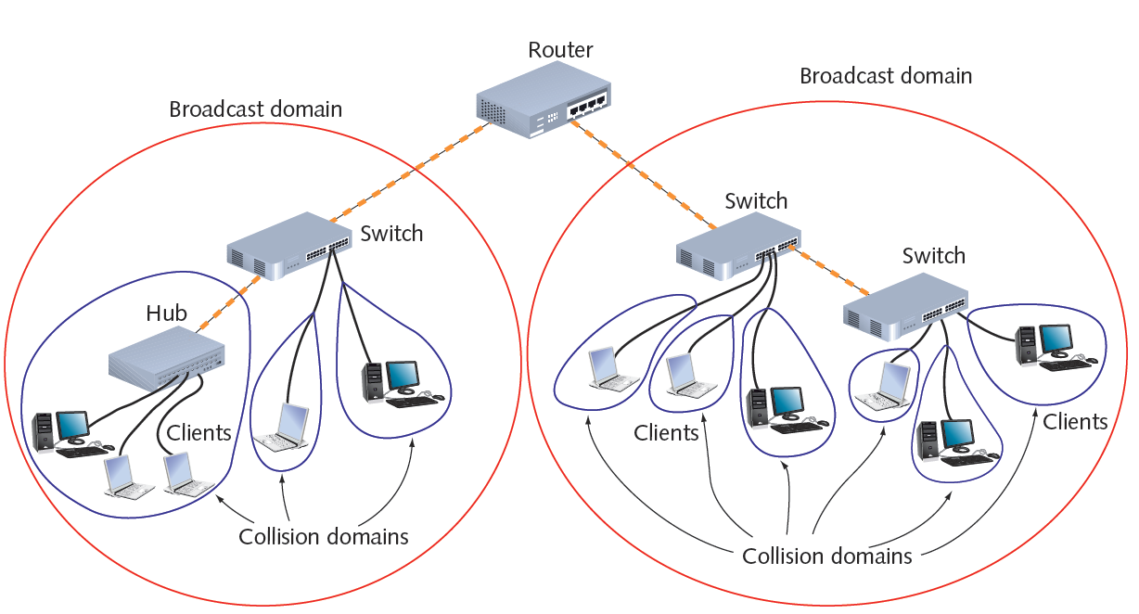
Figure 5-13 Broadcast domains and collision domains
Courtesy Course Technology/Cengage Learning

Slide 42
CSMA/CD (cont’d.)
Ethernet cabling distance limitations
Effected by collision domains
Data propagation delay
Data travel time too long
Cannot identify collisions accurately
100 or 1000 Mbps networks
Three segment maximum connected with two repeating devices
10 Mbps buses
Five segment maximum connected with four repeating devices

Slide 43
Ethernet Standards for Copper Cable
IEEE Physical layer standards
Specify how signals transmit to media
Differ significantly in signal encoding
Affect maximum throughput, segment length, wiring requirements

Slide 44
Ethernet Standards for Copper Cable (cont’d.)
10Base-T
10 represents maximum throughput: 10 Mbps
Base indicates baseband transmission
T stands for twisted pair
Two pairs of wires: transmit and receive
Full-duplex transmission
Follows 5-4-3 rule of networking
Five network segments
Four repeating devices
Three populated segments maximum

Slide 45
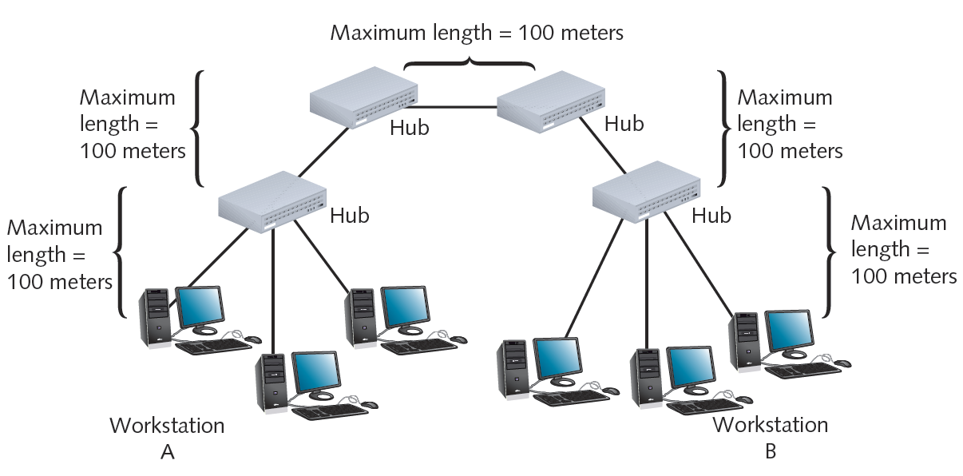
Figure 5-14 A 10Base-T network
Courtesy Course Technology/Cengage Learning

Slide 46
Ethernet Standards for Copper Cable (cont’d.)
100Base-T (Fast Ethernet)
IEEE 802.3u standard
Similarities with 10Base-T
Baseband transmission, star topology, RJ-45 connectors
Supports three network segments maximum
Connected with two repeating devices
100 meter segment length limit between nodes
100Base-TX
100-Mbps throughput over twisted pair
Full-duplex transmission: doubles effective bandwidth

Slide 47
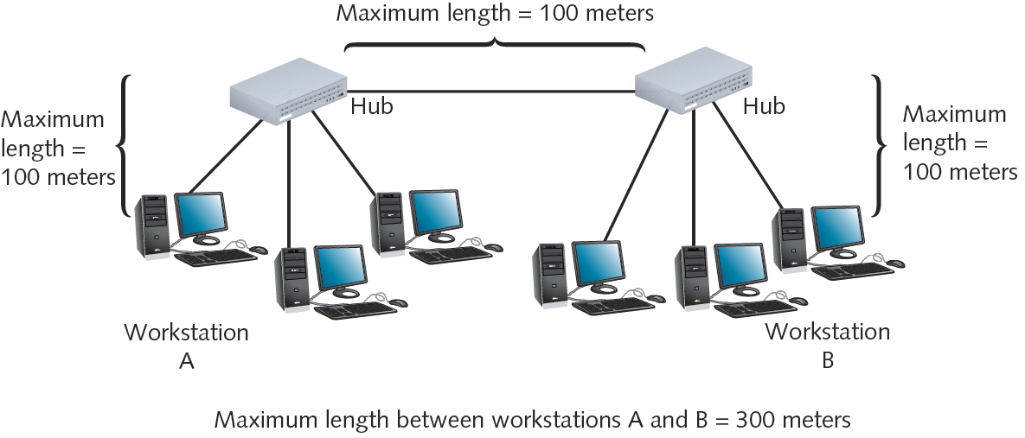
Figure 5-15 A 10Base-T network
Courtesy Course Technology/Cengage Learning

Slide 48
Ethernet Standards for Copper Cable (cont’d.)
1000Base-T (Gigabit Ethernet)
IEEE 802.3ab standard
1000 represents 1000 Mbps
Base indicates baseband transmission
T indicates twisted pair wiring
Four pairs of wires in Cat 5 or higher cable
Transmit and receive signals
Data encoding scheme: different from 100Base-T
Standards can be combined
Maximum segment length: 100 meters, one repeater

Slide 49
Ethernet Standards for Copper Cable (cont’d.)
10GBase-T
IEEE 802.3an
Pushing limits of twisted pair
Requires Cat 6, 6a, or 7 cabling
Maximum segment length: 100 meters
Benefits
Very fast data transmission
Cheaper than fiber-optic
Uses
Connect network devices
Connect servers, workstations to LAN

Slide 50
Ethernet Standards for Fiber-Optic Cable
100Base-FX (Fast Ethernet)
100-Mbps throughput, baseband, fiber-optic cabling
Multimode fiber containing at least two strands
Half-duplex mode
One strand receives; one strand transmits
412 meters segment length
Full duplex-mode
Both strands send and receive
2000 meters segment length
One repeater maximum
IEEE 802.3u standard

Slide 51
Ethernet Standards for Fiber-Optic Cable (cont’d.)
1000Base-LX (1-Gigabit Ethernet)
IEEE 802.3z standard
1000: 1000-Mbps throughput
Base: baseband transmission
LX: reliance on 1300 nanometers wavelengths
Longer reach than any other 1-gigabit technology
Single-mode fiber: 5000 meters maximum segment
Multimode fiber: 550 meters maximum segment
One repeater between segments
Excellent choice for long backbones

Slide 52
Ethernet Standards for Fiber-Optic Cable (cont’d.)
1000Base-SX (1-Gigabit Ethernet)
Differences from 1000Base-LX
Multimode fiber-optic cable (installation less expensive)
Uses short wavelengths (850 nanometers)
Maximum segment length dependencies
Fiber diameter, modal bandwidth used to transmit signals

Slide 53
Ethernet Standards for Fiber-Optic Cable (cont’d.)
1000Base-SX (cont’d.)
Modal bandwidth measurement
Highest frequency of multimode fiber signal (over specific distance)
MHz-km
Higher modal bandwidth, multimode fiber caries signal reliably longer
50 micron fibers: 550 meter maximum length
62.5 micron fibers: 275 meter maximum length
One repeater between segments
Best suited for shorter network runs

Slide 54
10-Gigabit Fiber-Optic Standards
Extraordinary potential for fiber-optic cable
Pushing limits
802.3ae standard
Fiber-optic Ethernet networks
Transmitting data at 10 Gbps
Several variations
Common characteristics
Star topology, allow one repeater, full-duplex mode
Differences
Signal’s light wavelength; maximum allowable segment length

Slide 55
10-Gigabit Fiber-Optic Standards (cont’d.)
10GBase-SR and 10GBase-SW
10G: 10 Gbps
Base: baseband transmission
S: short reach
Physical layer encoding
R works with LAN fiber connections
W works with SONET fiber connections
Multimode fiber: 850 nanometer signal transmission
Maximum segment length
Depends on fiber diameter

Slide 56
10-Gigabit Fiber-Optic Standards (cont’d.)
10GBase-LR and 10GBase-LW
10G: 10 Gbps
Base: baseband transmission
L: long reach
Single-mode fiber: 1310 nanometer signal transmission
Maximum segment length
10,000 meters
10GBase-LR: WAN or MAN
10GBase-LW: SONET WAN links

Slide 57
10-Gigabit Fiber-Optic Standards (cont’d.)
10GBase-ER and 10GBase-EW
E: extended reach
Single-mode fiber
Transmit signals with 1550 nanometer wavelengths
Longest fiber-optic segment reach
40,000 meters (25 miles)
10GBase-EW
Encoding for SONET
Best suited for WAN use

Slide 58
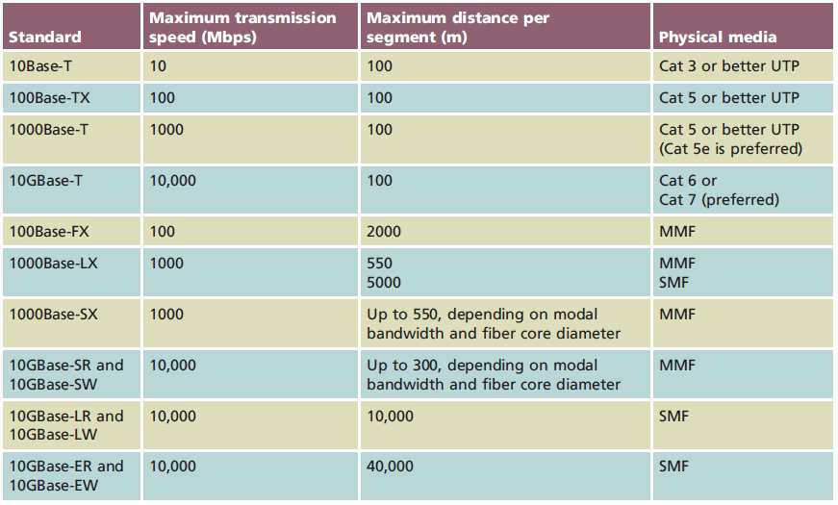
Summary of Common Ethernet Standards
Table 5-1 Common Ethernet standards
Courtesy Course Technology/Cengage Learning

Slide 59
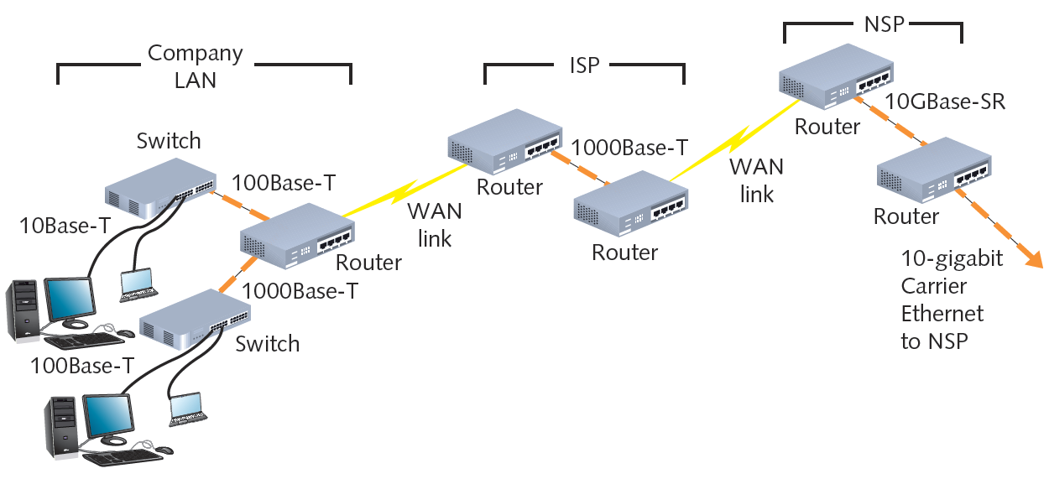
Figure 5-16 Multiple types of Ethernet on a WAN
Courtesy Course Technology/Cengage Learning

Slide 60
Ethernet Frames
Four types
Ethernet_802.2 (Raw)
Ethernet_802.3 (Novell proprietary)
Ethernet_II (DIX)
Ethernet_SNAP
Frame types differ slightly
Coding and decoding packets
No relation to topology, cabling characteristics
Framing
Independent of higher-level layers

Slide 61
Using and Configuring Frames
Ensure all devices use same, correct frame type
Node communication
Ethernet_II used today
Frame type configuration
Specified using NIC configuration software
NIC autodetect
Importance
Know frame type for troubleshooting

Slide 62
Frame Fields
Common fields
7-byte preamble, 1-byte start-of-frame delimiter
SFD (start-of-frame delimiter) identifies where data field begins
14-byte header
4-byte FCS (frame check sequence)
Frame size range: 64 to 1518 total bytes
Larger frame sizes result in faster throughput
Improve network performance
Properly manage frames

Slide 63
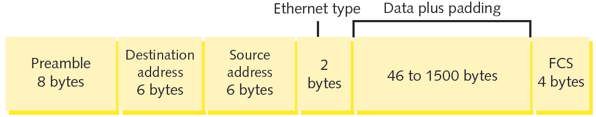
Ethernet_II (DIX)
Developed by DEC, Intel, Xerox (abbreviated DIX)
Before IEEE
Contains 2-byte type field
Identifies the Network layer protocol
Most commonly used on contemporary Ethernet networks
Figure 5-17 Ethernet II (DIX) frame
Courtesy Course Technology/Cengage Learning

Slide 64
PoE (Power over Ethernet)
IEEE 802.3af standard
Supplying electrical power over Ethernet connections
Two device types
PSE (power sourcing equipment)
PDs (powered devices)
Requires Cat 5 or better copper cable
Connectivity devices must support PoE
Compatible with current 802.3 installations

Slide 65
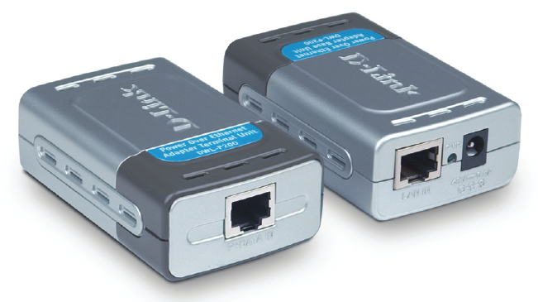
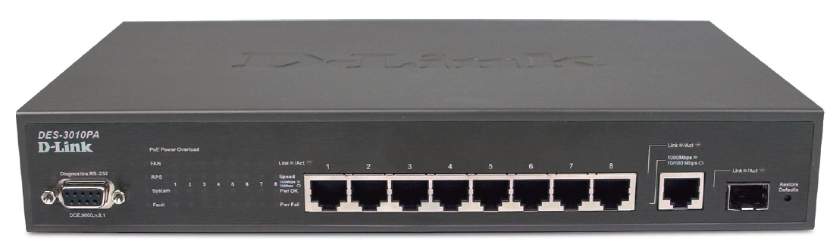
PoE (cont’d.)
Figure 5-18 PoE capable switch
Figure 5-19 PoE adapters
Courtesy D-Link North America
Courtesy D-Link North America

Slide 66
Summary
Physical topology describes basic network physical layout
Examples: bus, ring, star, hybrid
Logical topology describes signal transmission
Network backbones
Serial, distributed, collapsed, parallel
Switching
Manages packet filtering, forwarding
Ethernet
Cabling specifications, data frames, PoE

